Slide 1
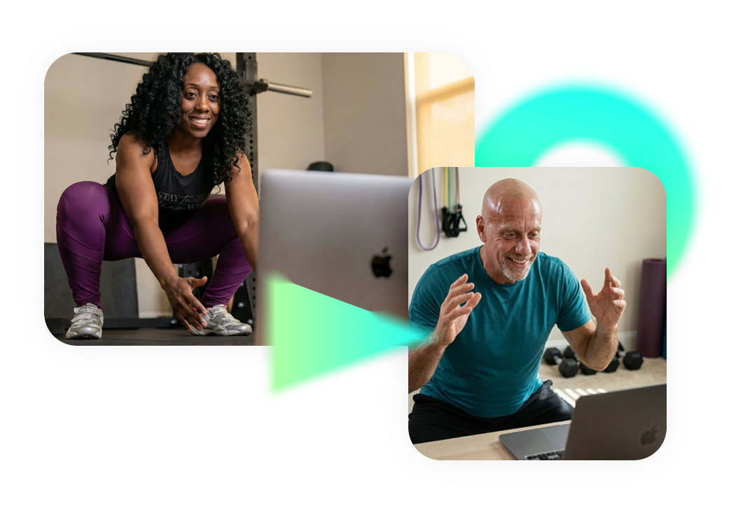




INSERT SESSION TITLE HERE
INSERT PRESENTER NAME HERE

Slide 2
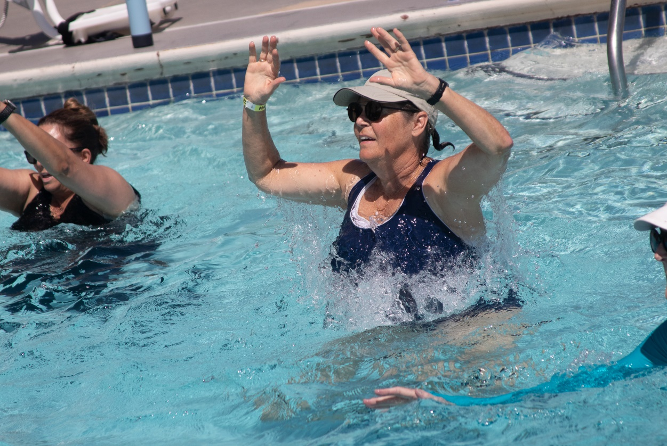
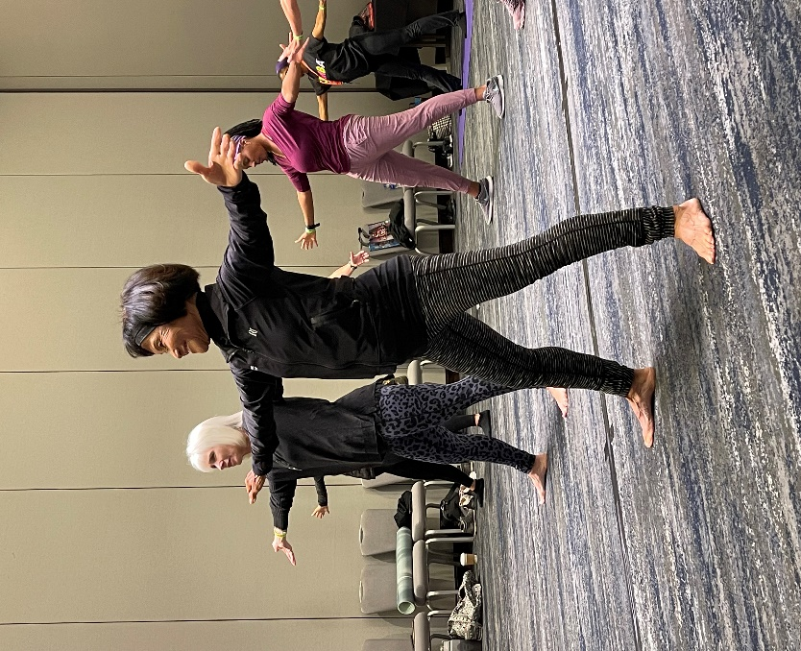
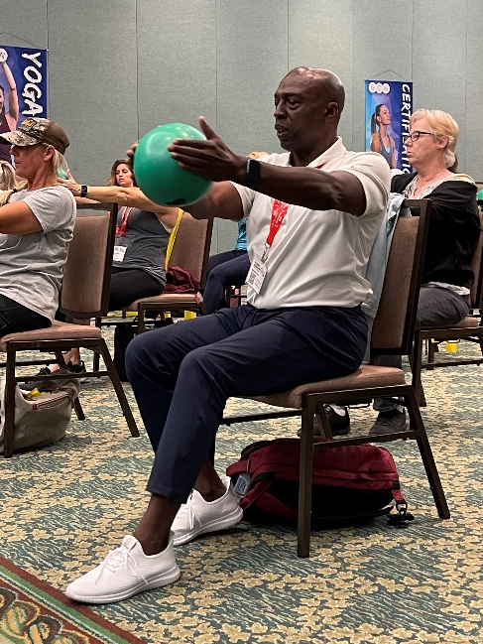
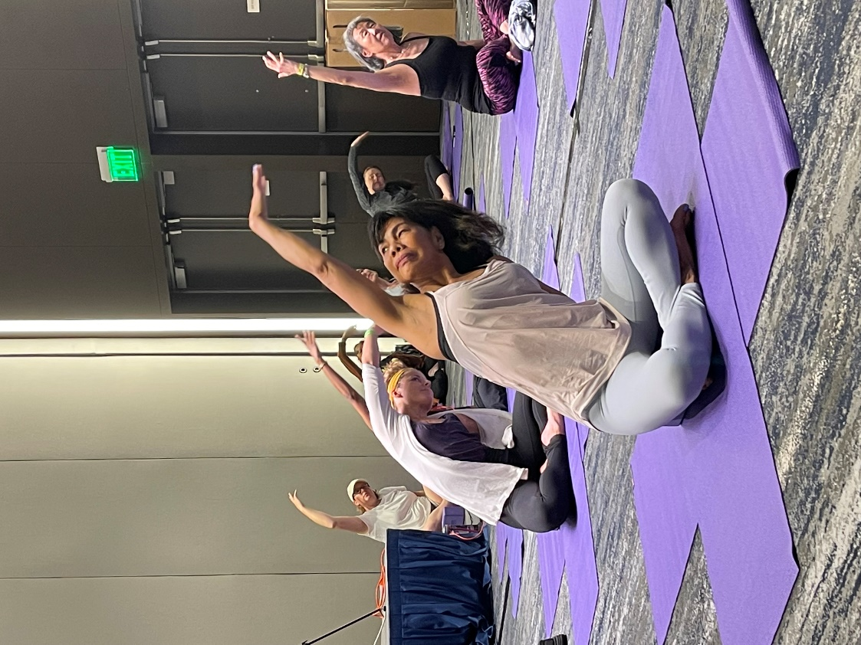




@SCWMANIA
#LIVESTREAMMANIA

Slide 3





ONLINE
CERTIFICATIONS
Manual
Videos
Exam
LIVE COURSE FREE
scwfit.com/certs
• Personal Training
• Group Exercise
• Pilates Matwork
• Stretching & Flexibility
• Barre

Slide 4
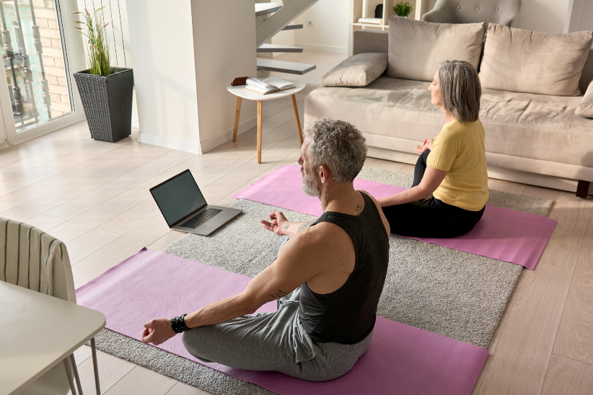

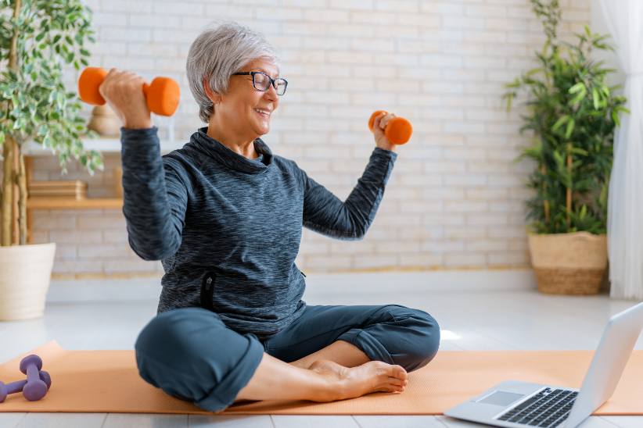
RECORDINGS
$40 FOR 40 DAYS
All 108 Live-Stream Zoom Sessions & Recordings
livestreammania.com/register

Slide 5





eNewsletters
Webinars
Podcasts
FREE RESOURCES

