Slide 1
























INSERT SESSION TITLE HERE
INSERT PRESENTER NAME HERE

Slide 2
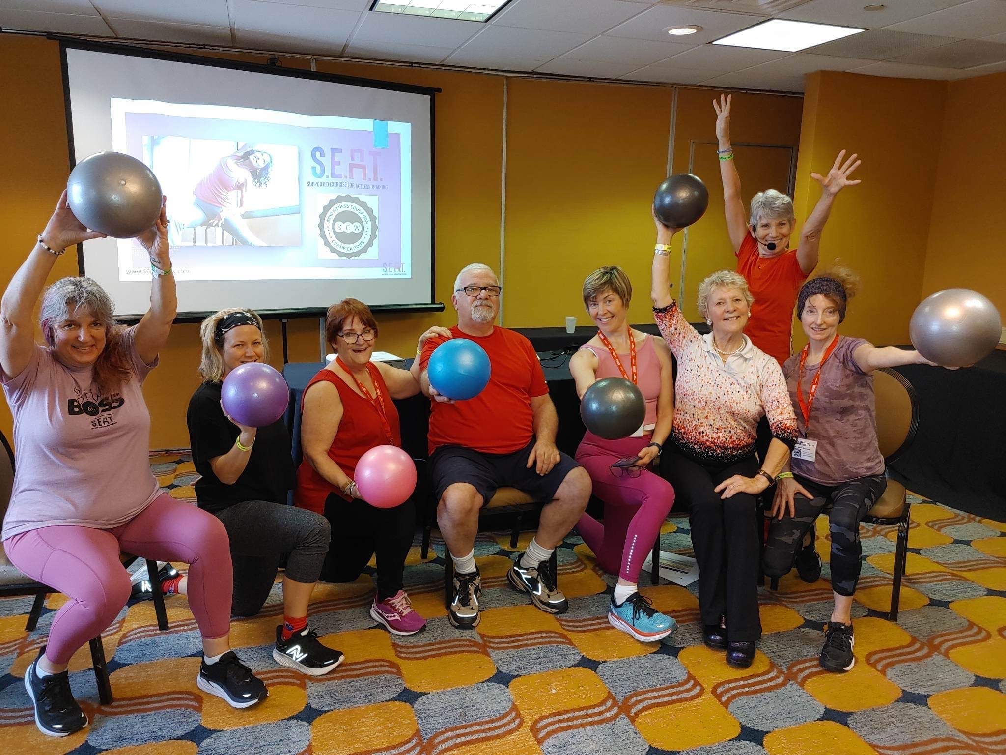
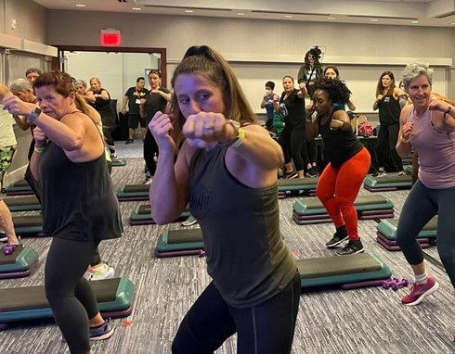
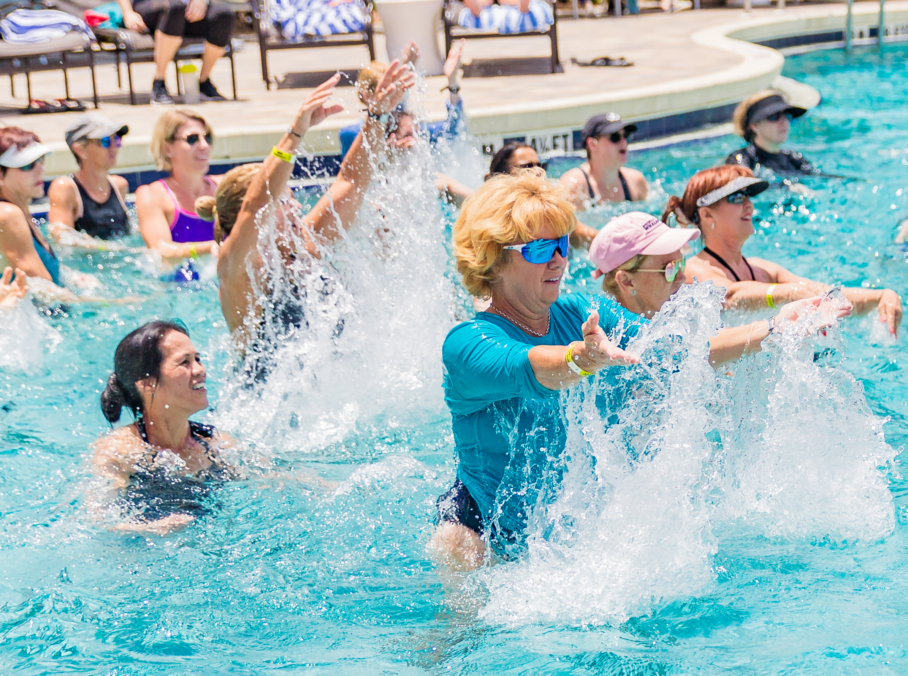
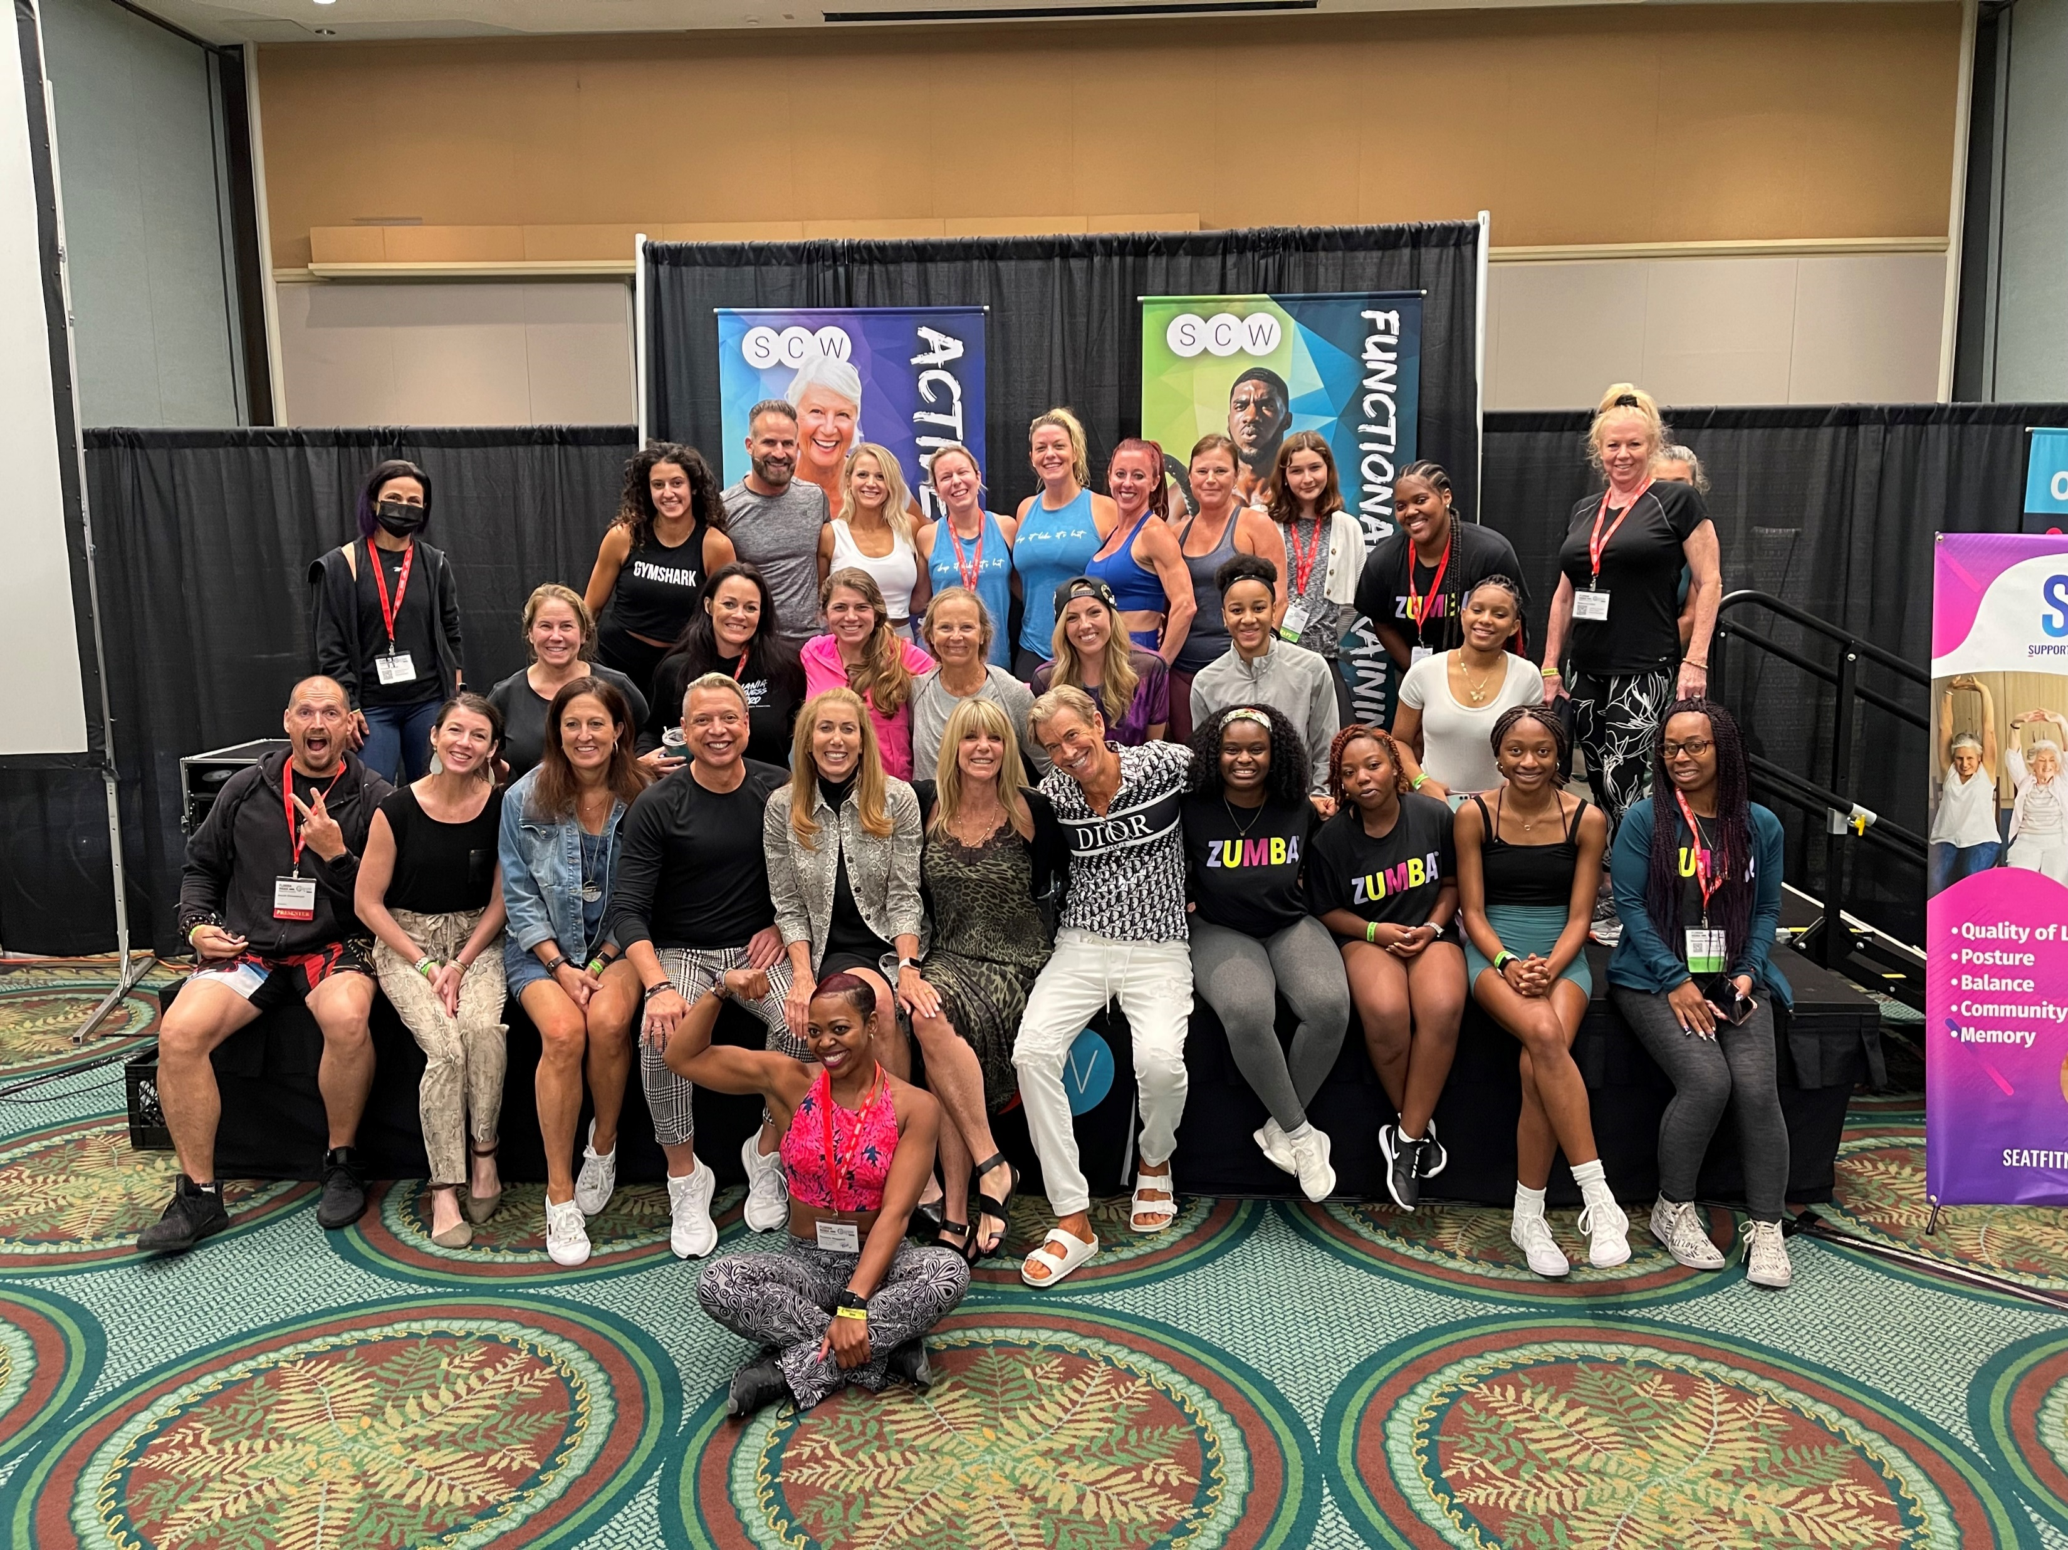
Share your MANIA®
pics/videos with us
@SCWMANIA
#SCWMANIA

Slide 3





ONLINE
CERTIFICATIONS
Manual
Videos
Exam
LIVE COURSE FREE
scwfit.com/certs

Slide 4
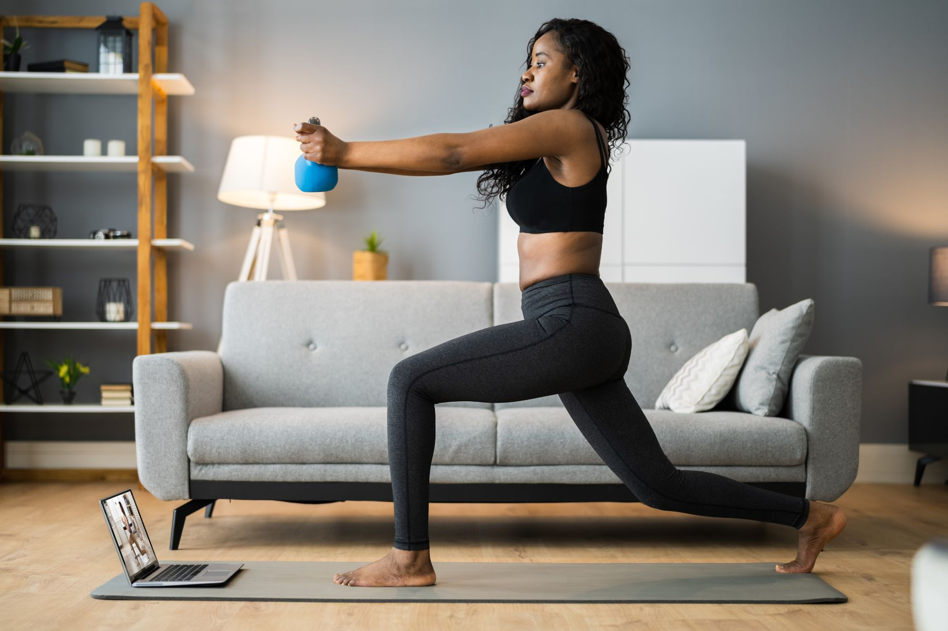



RECORDINGS
$60 FOR 60 DAYS
EQUIPMENT
50% OFF
APPAREL
50% OFF

Slide 5





FREE RESOURCES
eNewsletters
Webinars
Podcasts

Slide 6
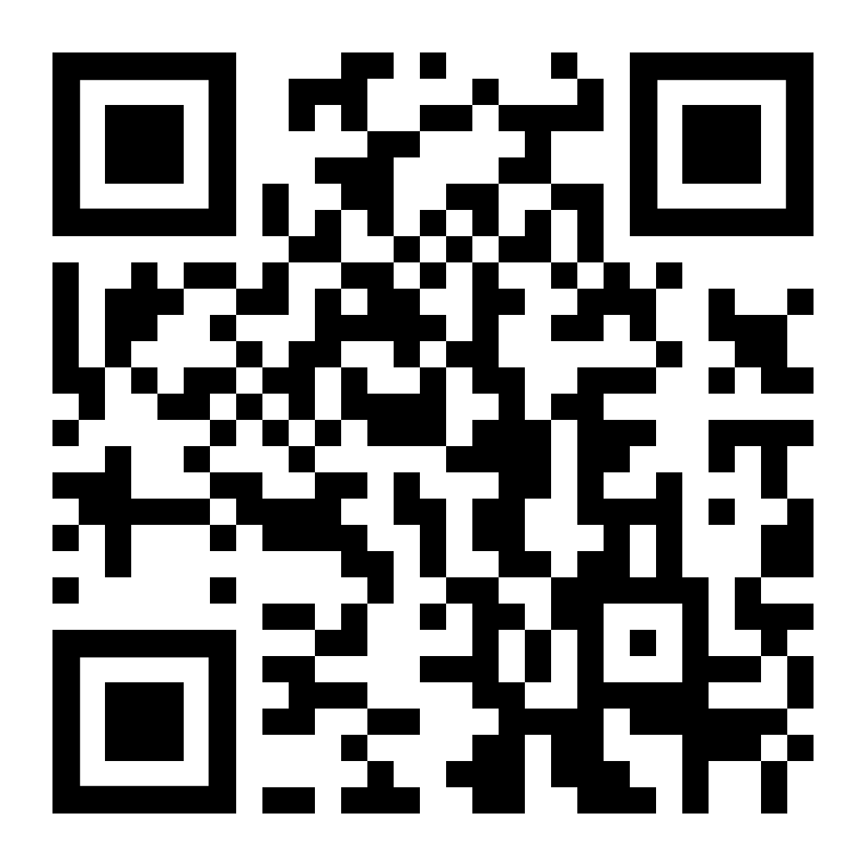
ATTENDEE HOMEPAGE

