Slide 1




INSERT SESSION TITLE HERE
INSERT PRESENTER NAME HERE

Slide 2


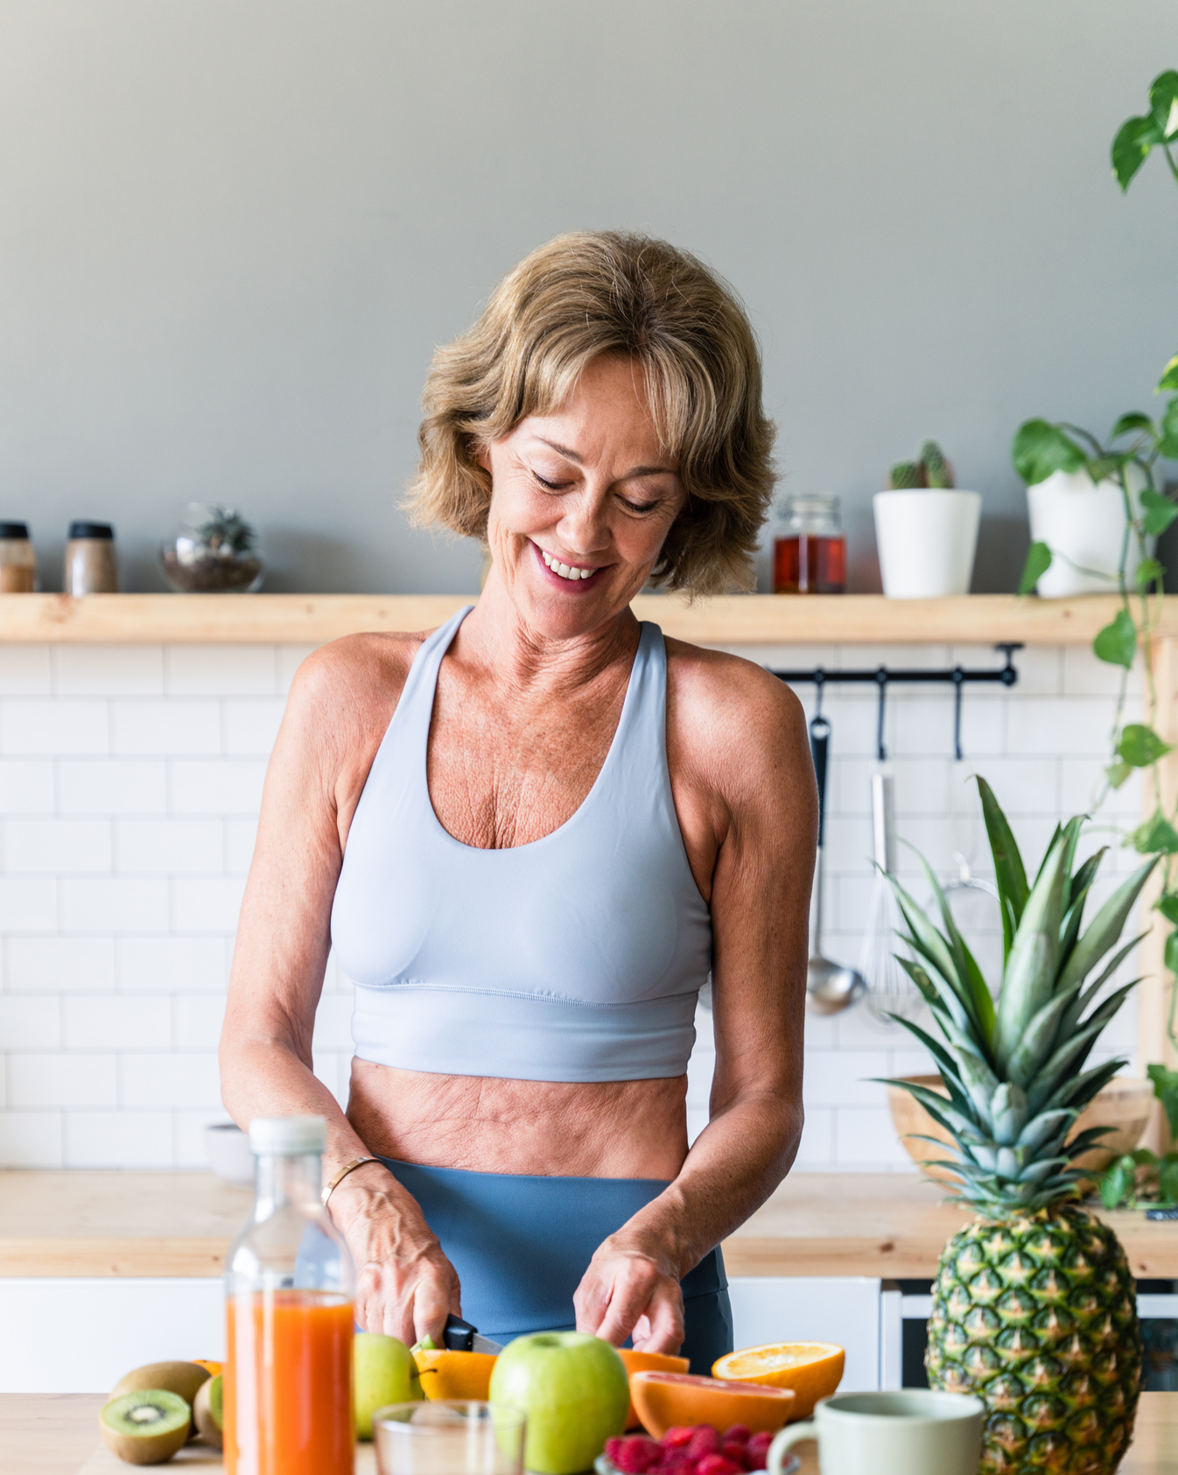




@SCWMANIA
#NUTRITIONCOACHINGSUMMIT

Slide 3





ONLINE
CERTIFICATIONS
Manual
Videos
Exam
LIVE COURSE FREE
scwfit.com/certs
• Nutrition Coaching for Fitness Professionals
• Active Aging Nutrition
• Menopause Wellness
• Sports Nutrition
• Nutrition, Hormones, & Metabolism
• Weight Management

Slide 4



RECORDINGS
$40 FOR 40 DAYS
All 108 Live-Stream Zoom Sessions & Recordings
NutritionCoachingSummit.com/register

Slide 5





eNewsletters
Webinars
Podcasts
FREE RESOURCES

