Slide 1
SESSION TITLE HERE PRESENTER NAME HERE

Slide 2
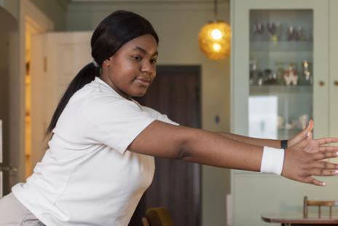
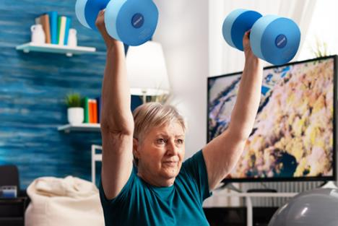
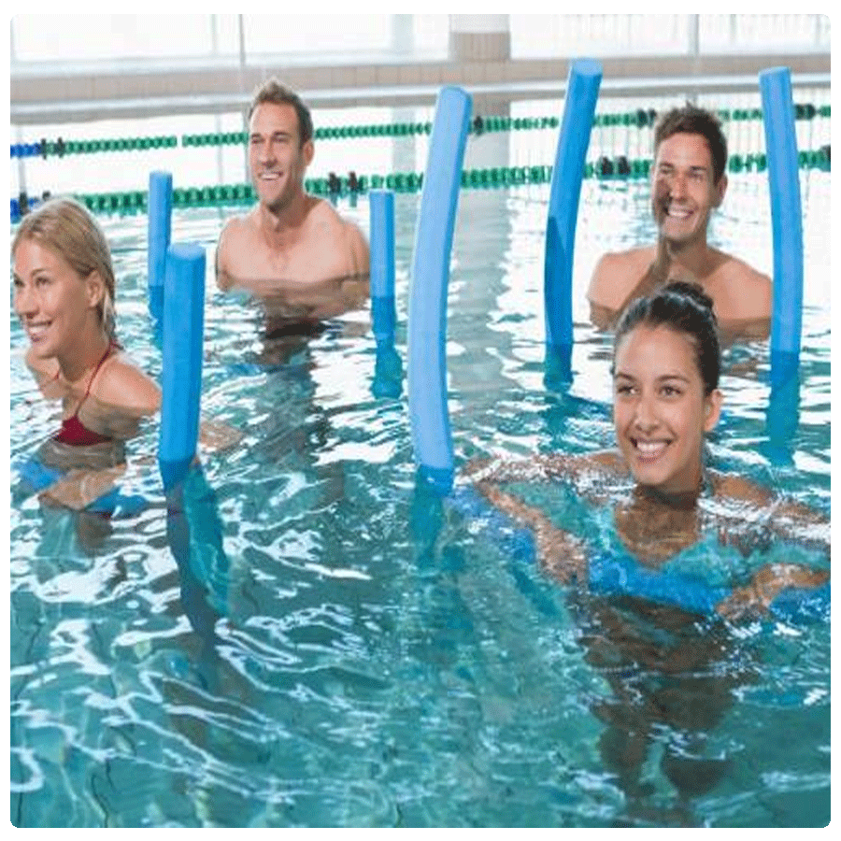
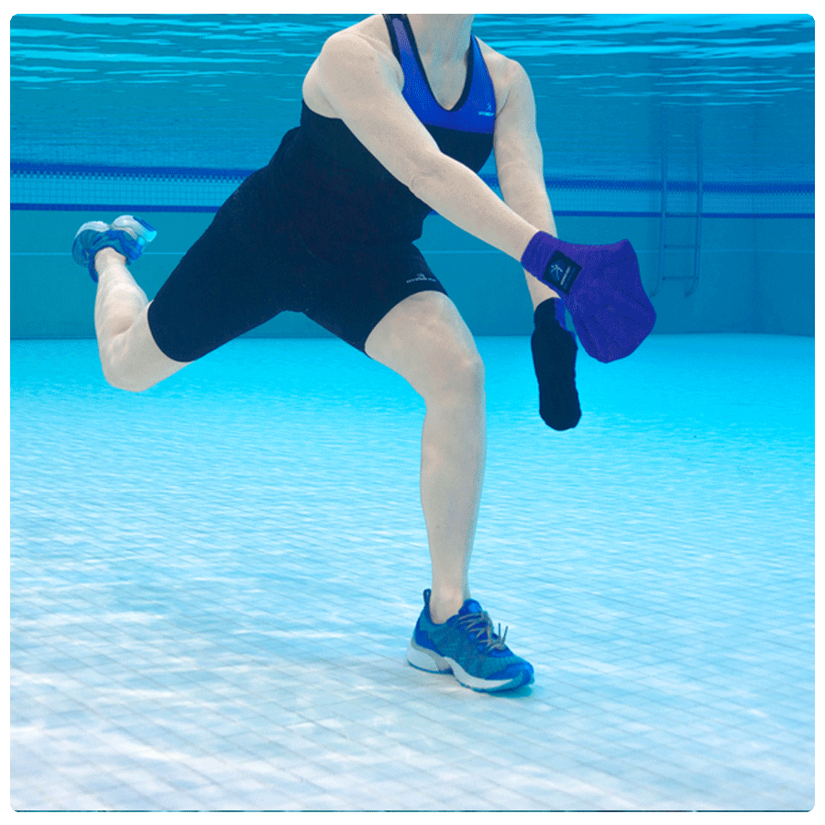
RECORDINGS
$30 for 30 Days
EQUIPMENT
Up To 50% Off
CLOTHING
Up To 50% Off

Slide 3
SCW Tidal Waves
Your FREE Monthly Aqua Newsletter
scwfit.com/info
Notes:
To change the image behind the Mock up.
Select the layer - > Right Click -> Send to Back -> Delete the image -> Drag & Drop your Own Picture -> Send to Back (again)

Slide 4
Give Us a BIG WAVE on Social
#SCWMANIA
#AQUAEXSUMMIT

Slide 5
SCW
SCW AQUA EXERCISE
Online Certifications
CERTIFICATION
COURSE
Each Course Includes:
MANUAL
VIDEO
EXAM
FREE LIVE COURSE
scwfit.com/certs

