Slide 1
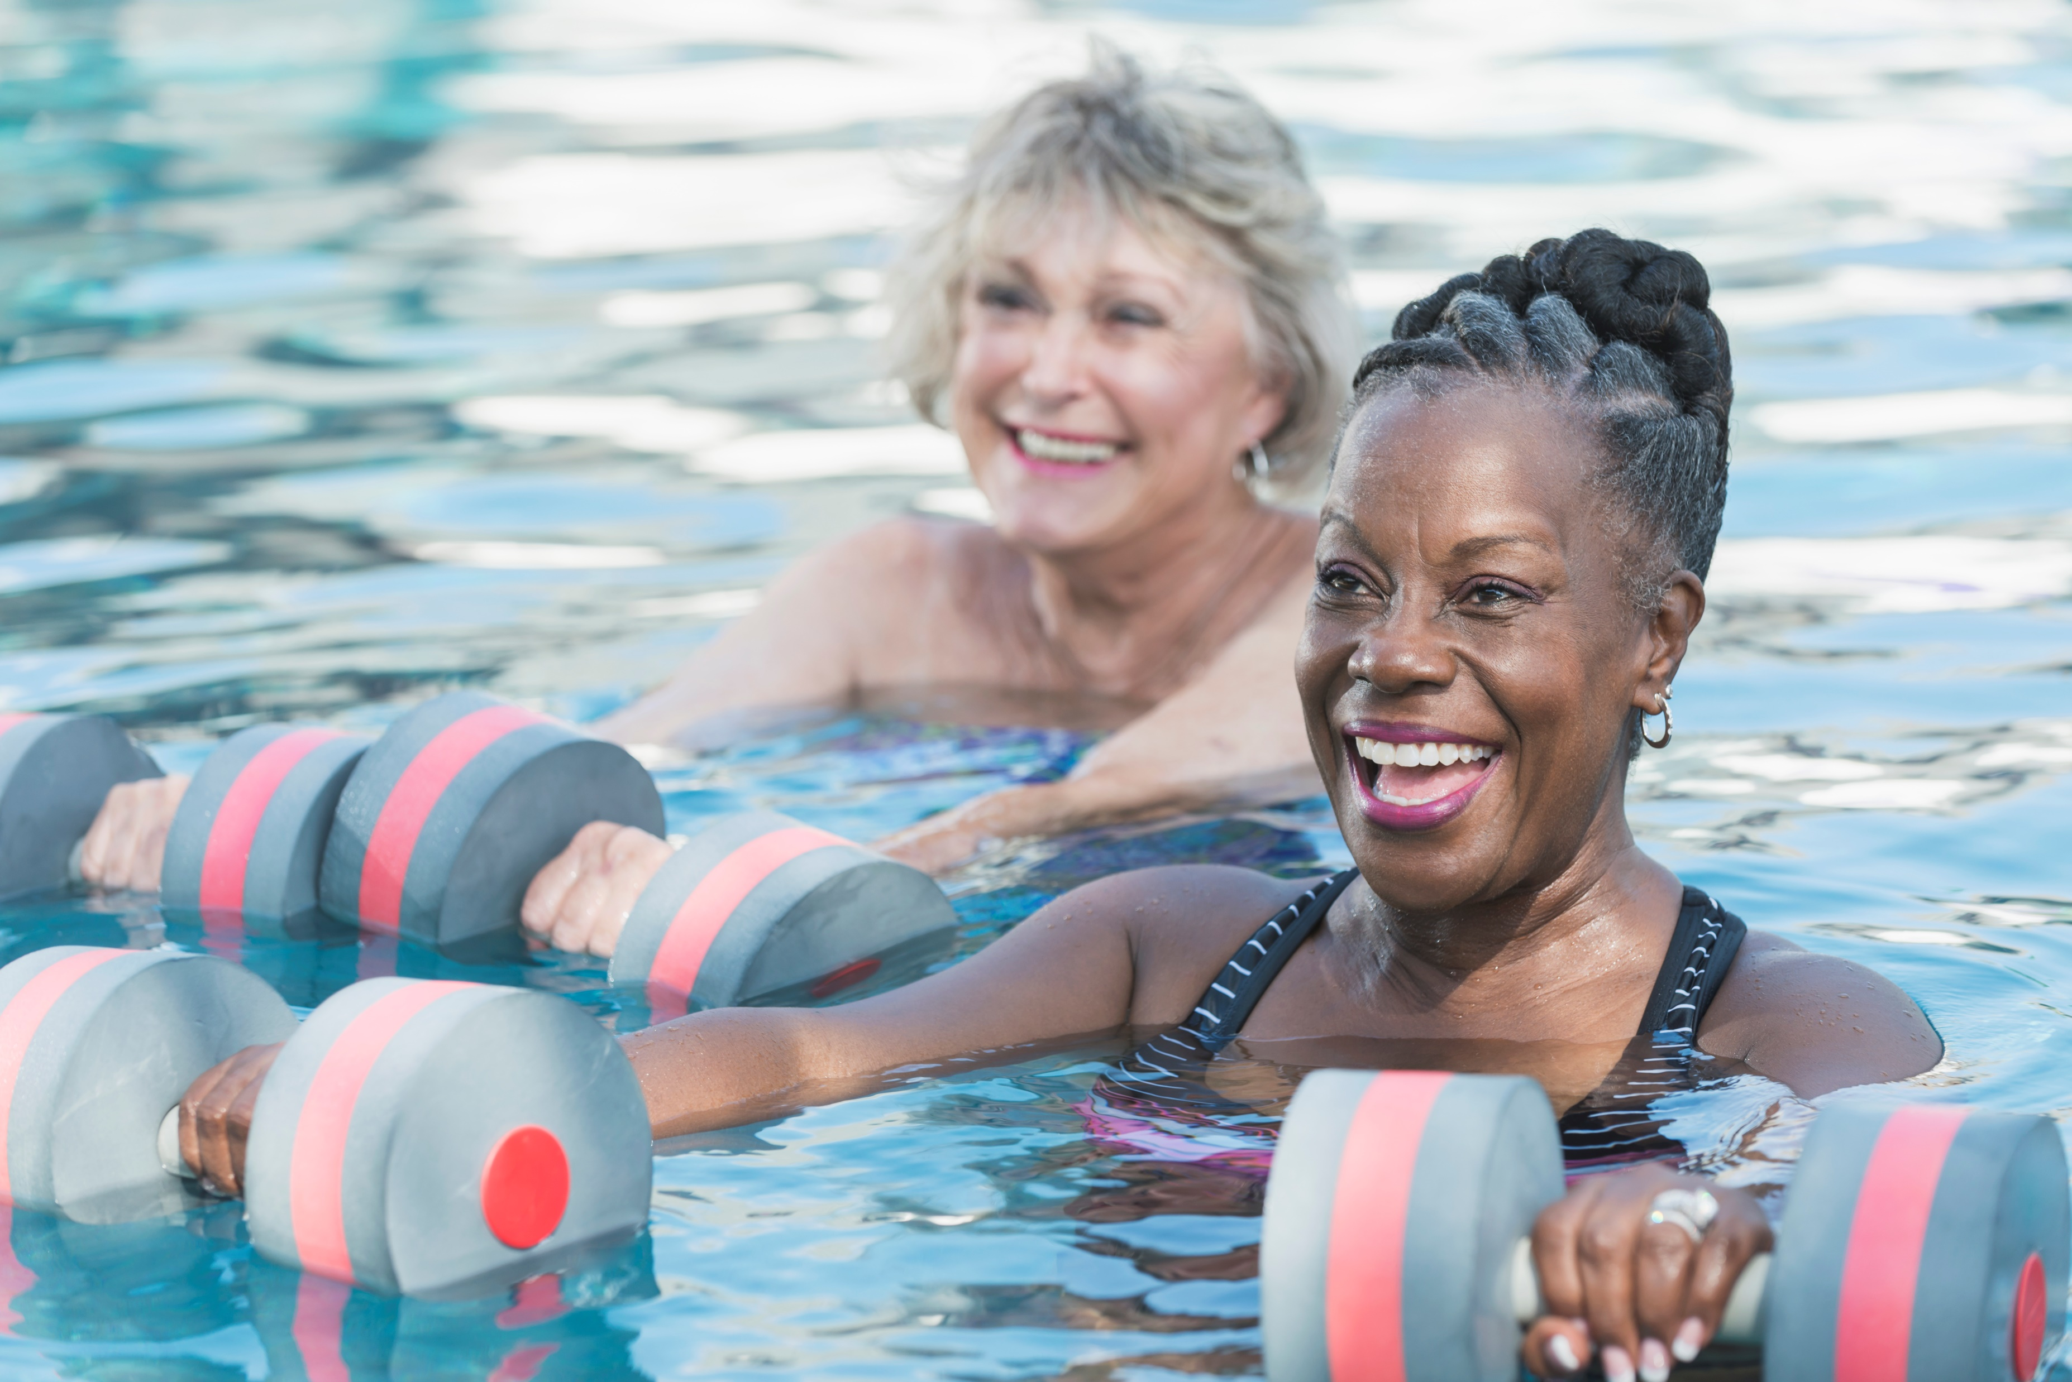
SESSION TITLE HERE PRESENTER NAME HERE

Slide 2
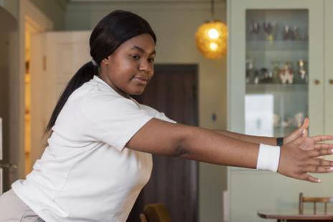
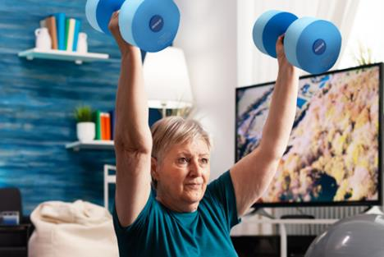
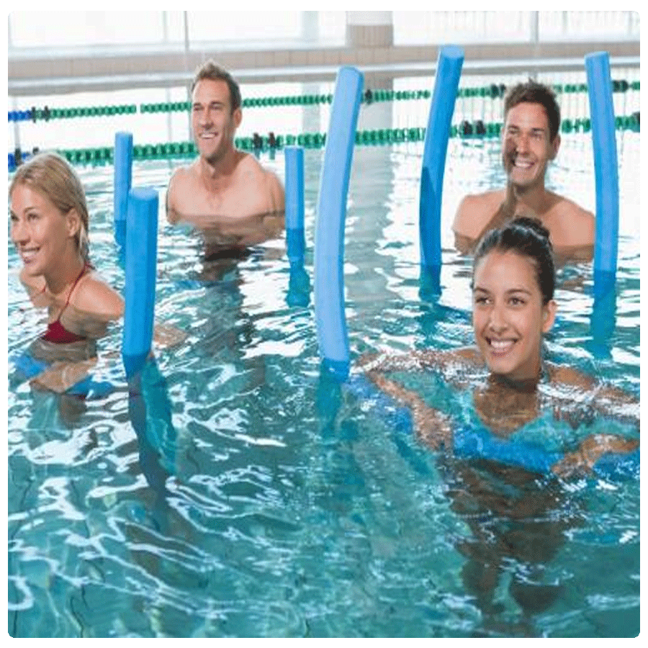
RECORDINGS
$30 for 30 Days
EQUIPMENT
Up to 50% Off
CLOTHING
Up to 50% Off

Slide 3
SCW Tidal Waves
Your FREE Monthly Aqua Newsletter
scwfit.com/info

Slide 4
Give Us a BIG WAVE on Social
#SCWMANIA
#AQUAEXSUMMIT

Slide 5
SCW
Online Certifications
SCW AQUA EX
CERTIFCIATON
COURSE
Each Course Includes:
MANUAL
VIDEO
EXAM
FREE LIVE COURSE
scwfit.com/certs

