Slide 1



SESSION TITLE HERE
PRESENTER NAME HERE

Slide 2
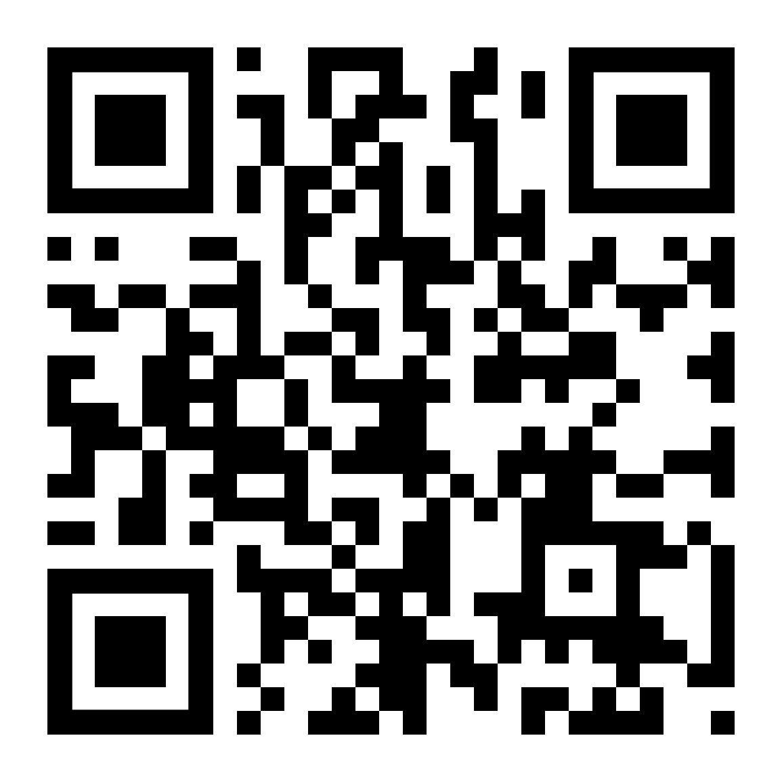
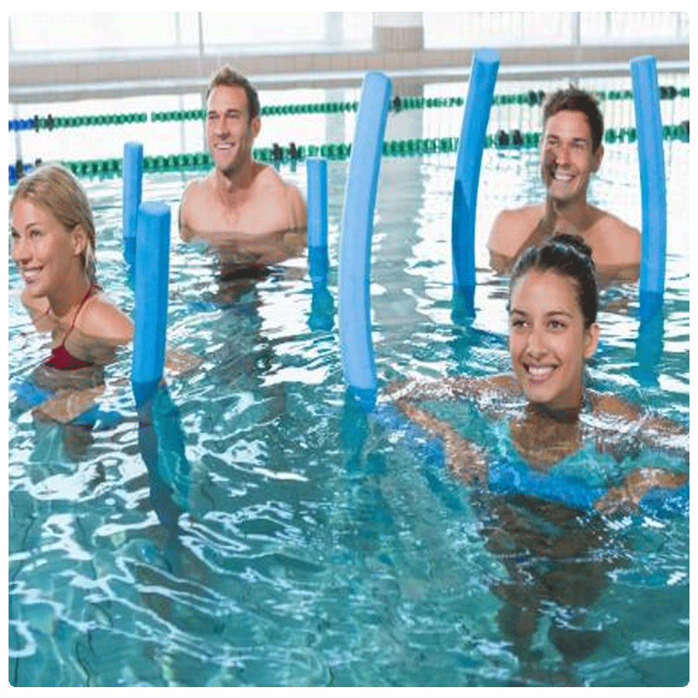
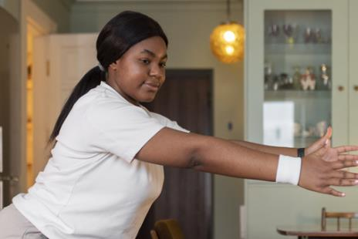

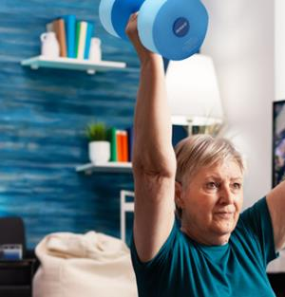
ADD RECORDINGS - $60 for 60 Days
aquaexsummit.com/register/add/

Slide 3

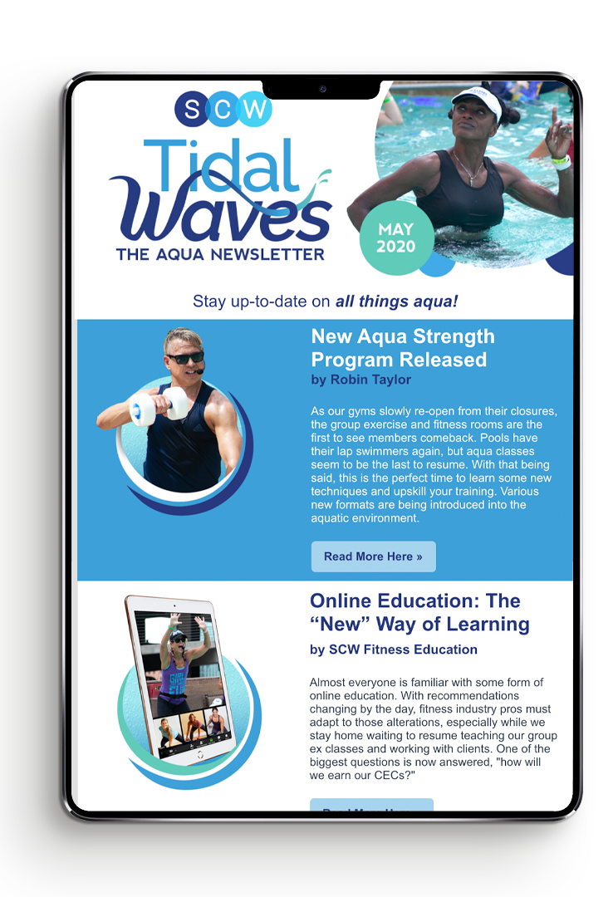
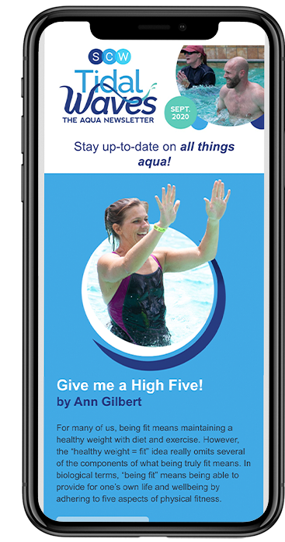
SCW Tidal Waves
Your FREE
Monthly
Aqua
Newsletter
scwfit.com/tidalwaves
Notes:
To change the image behind the Mock up.
Select the layer - > Right Click -> Send to Back -> Delete the image -> Drag & Drop your Own Picture -> Send to Back (again)

Slide 4

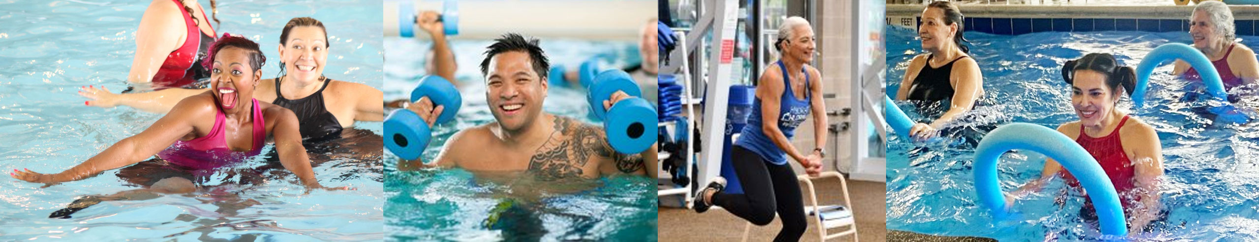
Give Us a BIG WAVE on Social
#SCWMANIA
#AQUAEXSUMMIT

Slide 5
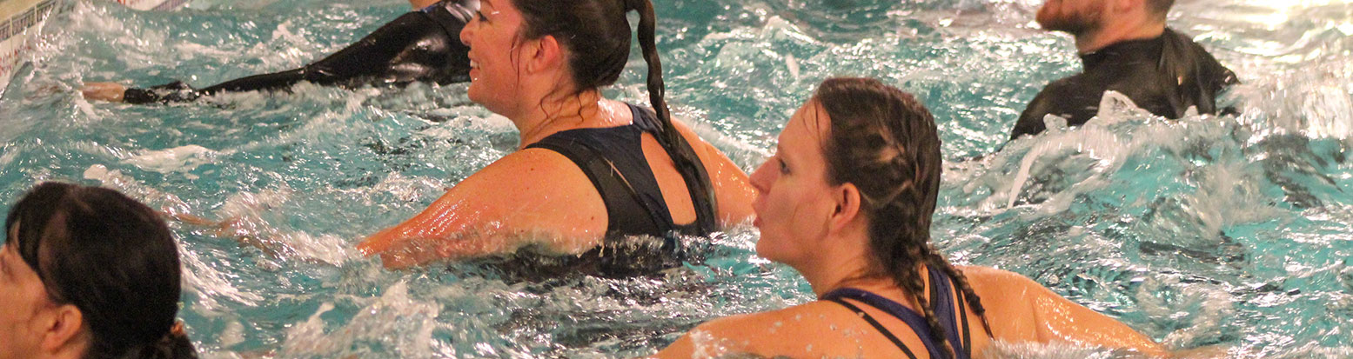


SCW
SCW AQUA EXERCISE
Online Certifications
CERTIFICATION
COURSE
Each Course Includes:
MANUAL
VIDEO
EXAM
  FREE LIVE COURSE
scwfit.com/certs

