Slide 1



SESSION TITLE HERE
PRESENTER NAME HERE

Slide 2

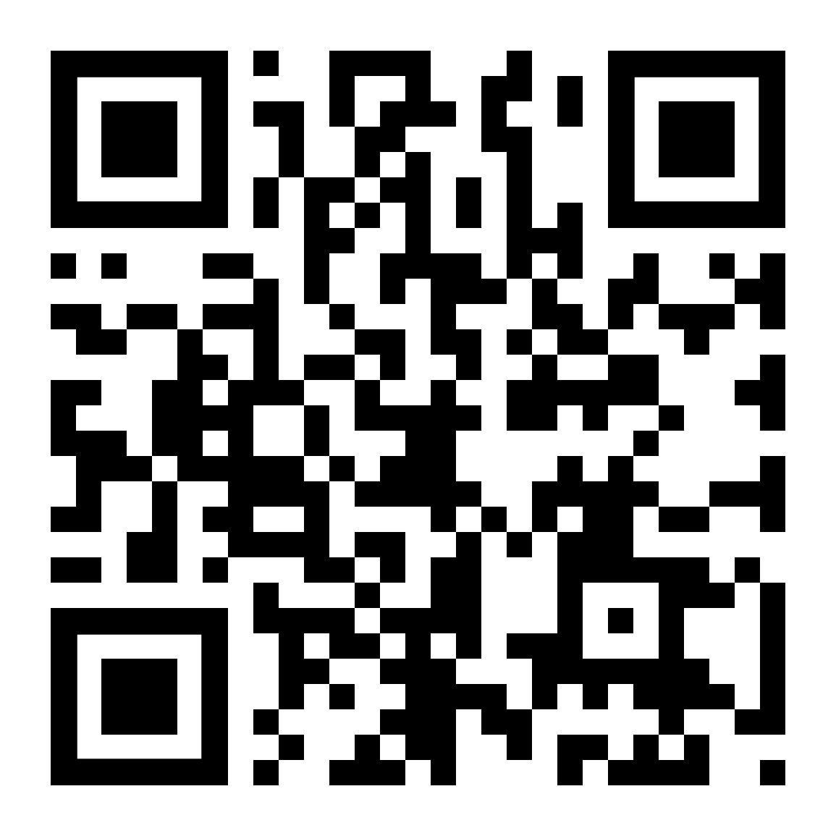
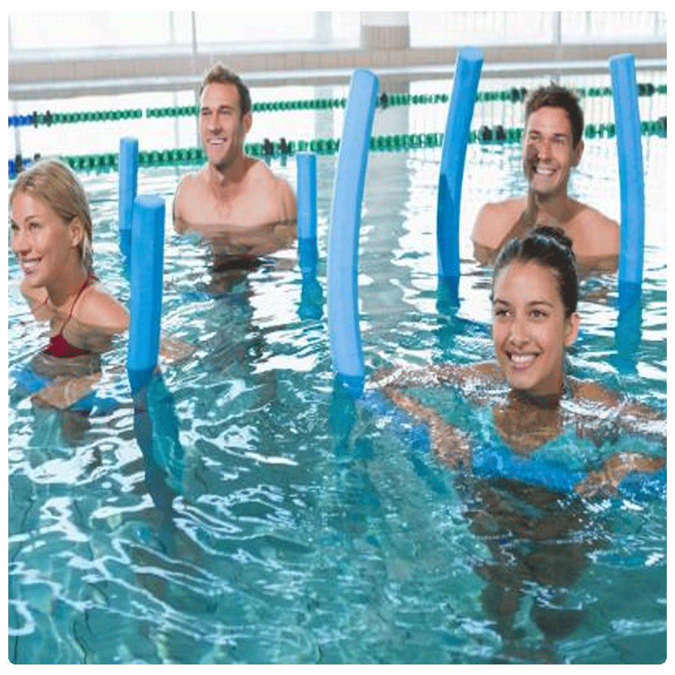
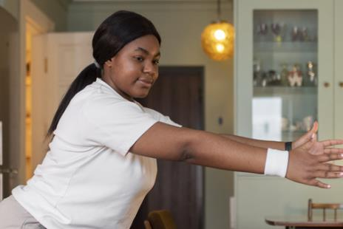

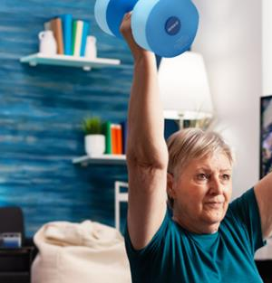
ADD RECORDINGS - $60 for 60 Days
aquaexsummit.com/register/add/

Slide 3
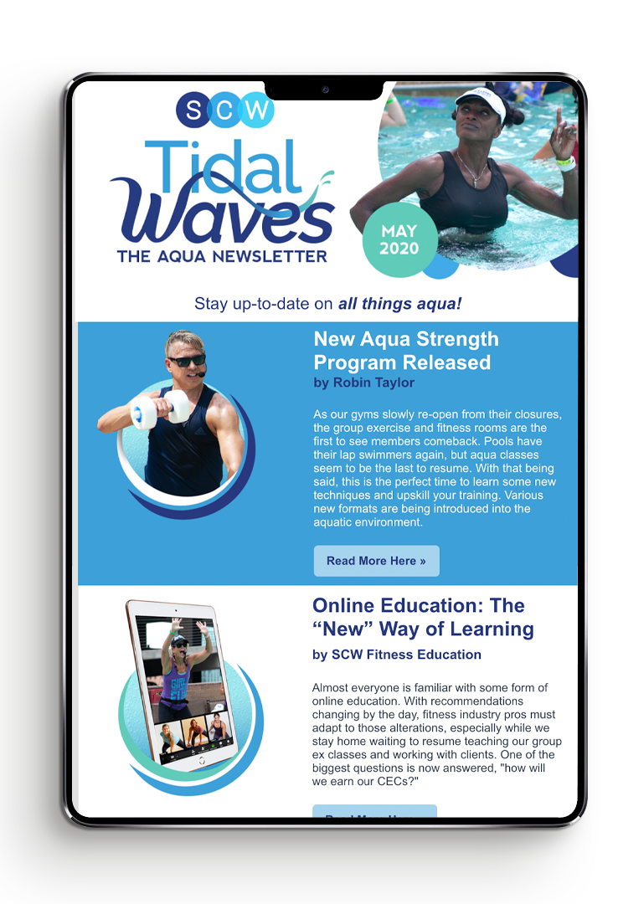
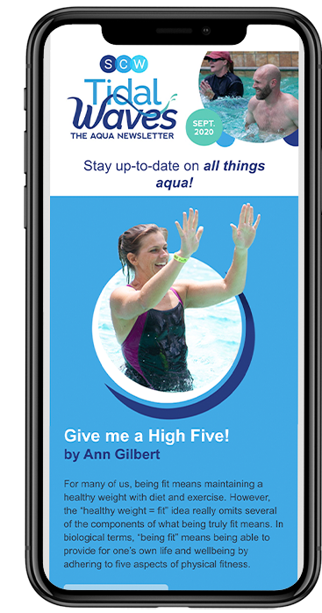
SCW Tidal Waves
Your FREE
Monthly
Aqua
Newsletter
scwfit.com/tidalwaves

Slide 4

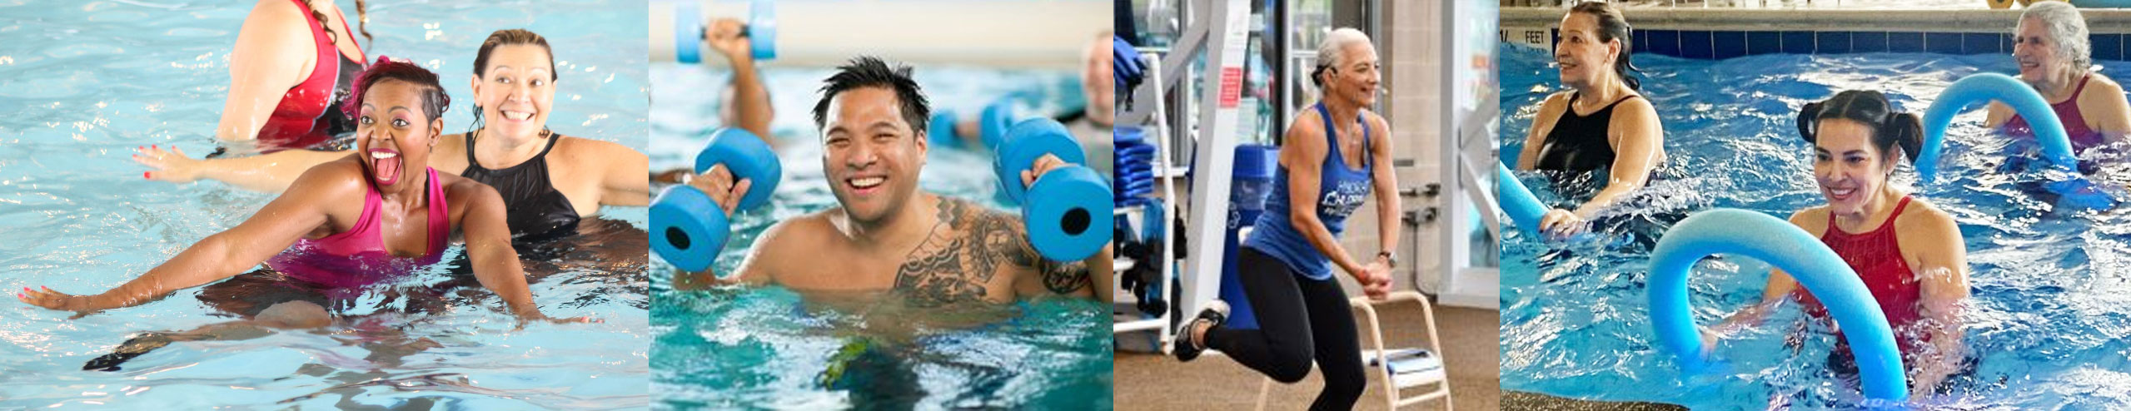
Give Us a BIG WAVE on Social
#SCWMANIA
#AQUAEXSUMMIT

Slide 5
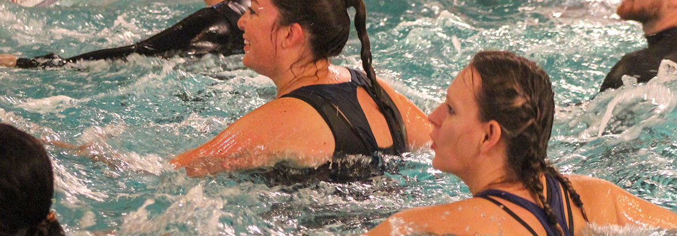


SCW
Online Certifications
SCW AQUA EX
CERTIFICATION
COURSE
Each Course Includes:
MANUAL
VIDEO
EXAM
FREE LIVE COURSE
scwfit.com/certs

