Slide 1









March 21-22
INSERT SESSION TITLE HERE
INSERT PRESENTER NAME HERE

Slide 2
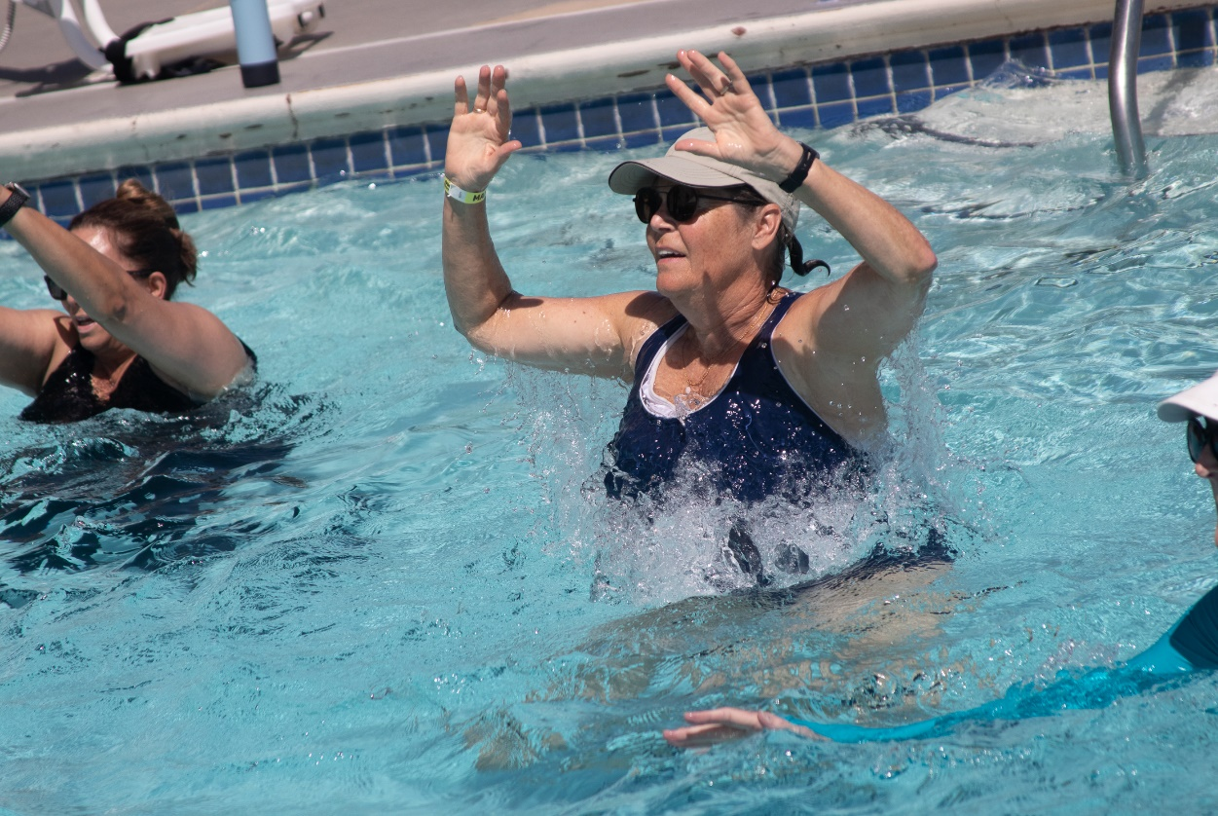
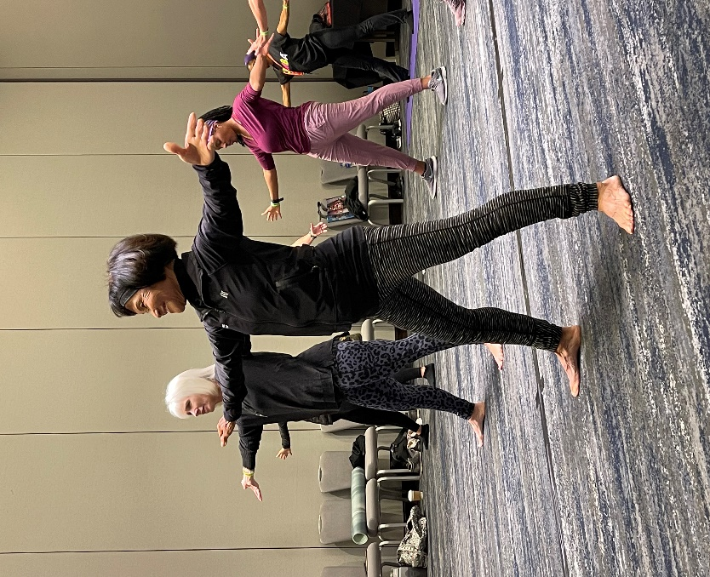
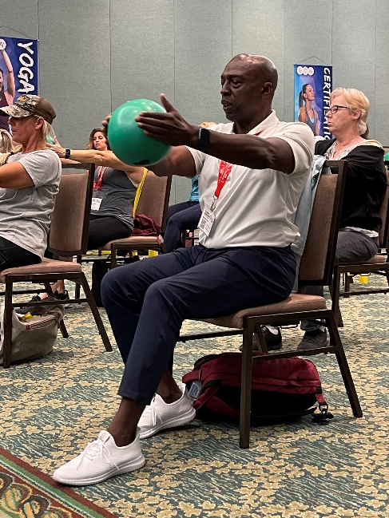
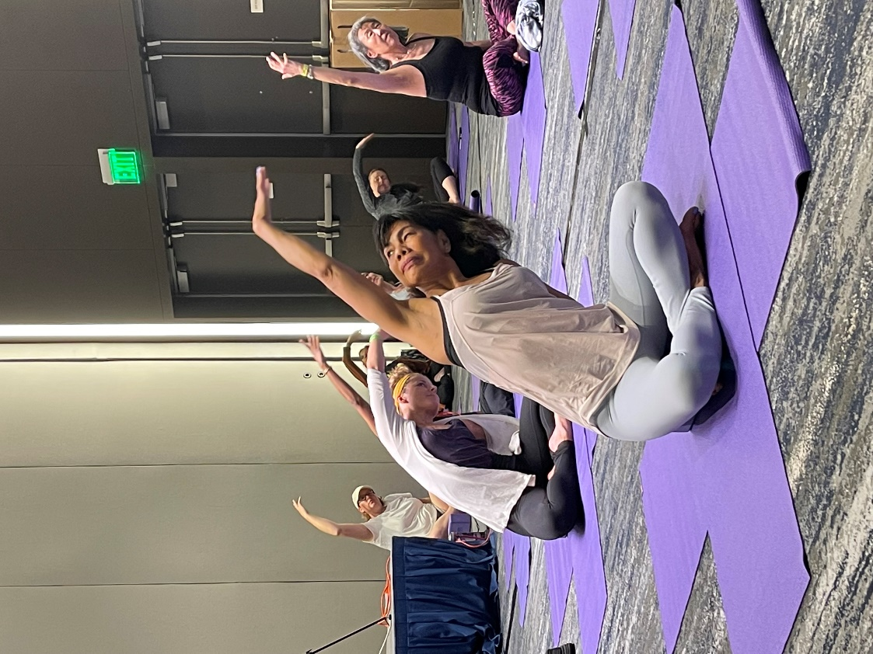




@SCWMANIA
#ACTIVEAGINGSUMMIT

Slide 3





ONLINE
CERTIFICATIONS
Manual
Videos
Exam
LIVE COURSE FREE
scwfit.com/certs
Active Aging
Active Aging Nutrition
Functional Training
Life Coaching
S.E.A.T. (Supported Exercise for Ageless Training)

Slide 4



RECORDINGS
$40 FOR 40 DAYS
All 80 Live-Stream Zoom Sessions & Recordings
activeagingsummit.com/register/active-aging-live-recorded/

Slide 5





eNewsletters
Webinars
Podcasts
FREE RESOURCES

