Slide 1
INSERT SESSION TITLE HERE
INSERT PRESENTER NAME HERE

Slide 2
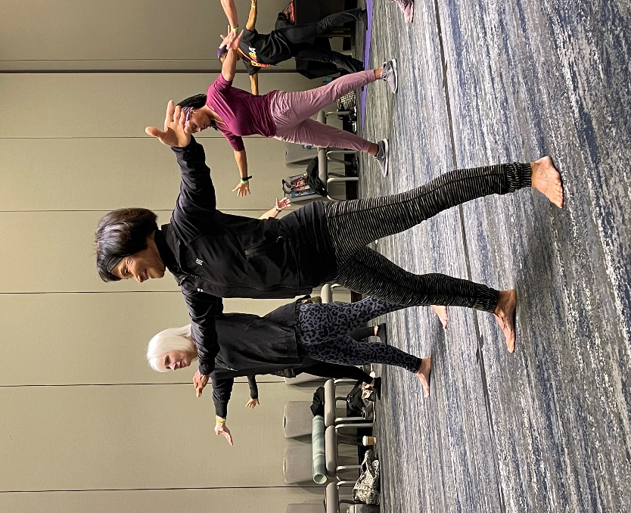
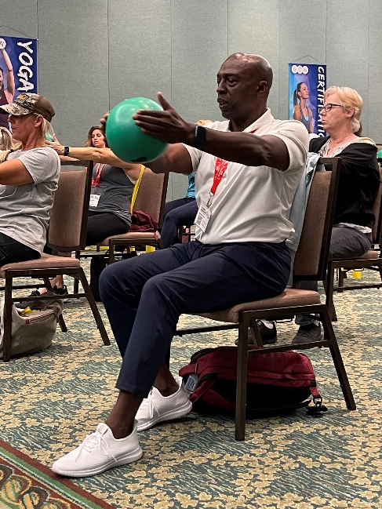
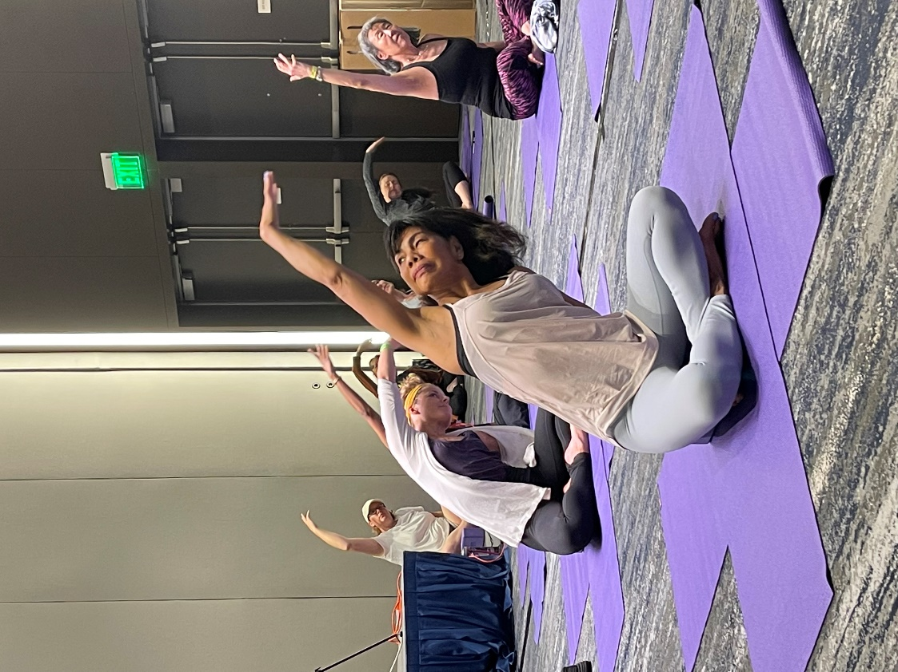
@SCWMANIA
#ACTIVEAGINGSUMMIT

Slide 3
ONLINE
CERTIFICATIONS
Manual
Videos
Exam
LIVE COURSE FREE
scwfit.com/certs
Active Aging
Active Aging Nutrition
Functional Training
Life Coaching
S.E.A.T. (Supported Exercise for Ageless Training)

Slide 4
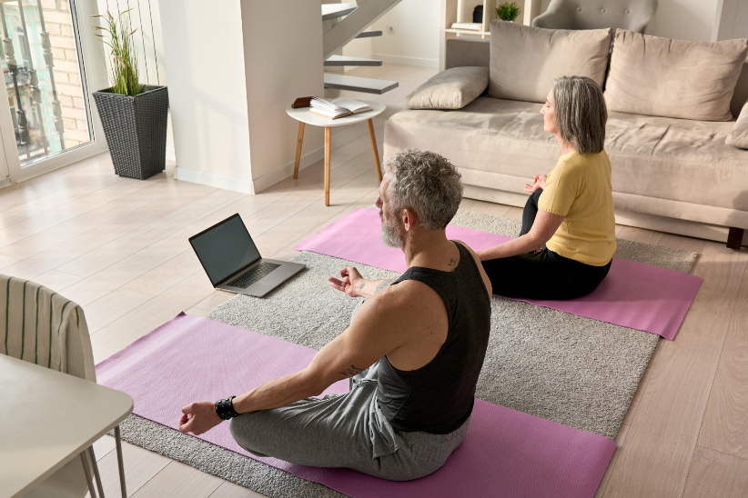
RECORDINGS
$40 FOR 40 DAYS
EQUIPMENT
50% OFF
CLOTHING
50% OFF

Slide 5
FREE RESOURCES
eNewsletters
Webinars & Podcasts

